Slide 1


Microprocessors and Assembly Language Spring 2020
Hamed Farbeh
farbeh@aut.ac.ir
Department of Computer Engineering
Amirkabir University of Technology
Lecture 18

Slide 2
Copyright Notice
Parts (text & figures) of this lecture are adopted from:
Arm Assembly Language Programming and Architecture, Volume 1, 1st edition, Muhammad Ali Mazidi, Sarmad Naimi, and Sepehr Naimi, MicroDigitalEd, 2013.
Microprocessors and Assembly Language, Spring 2020, AUT, Tehran, Iran

Slide 3

Instruction Formation of the ARM
Microprocessors and Assembly Language, Spring 2020, AUT, Tehran, Iran

Slide 4
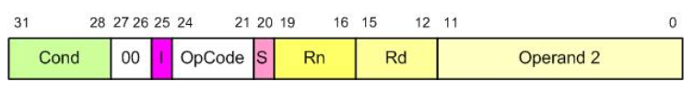
Instruction Formation
General formation of data processing instructions
Cond [31:28]: Condition field (will be discussed in Ch. 4)
[27:26]: Always “00”
I [25]: Defines the type of second operand
I = 1: Op2 is an immediate value
[24:21]: Opcode
S [20]: Update CPSR
Microprocessors and Assembly Language, Spring 2020, AUT, Tehran, Iran

Slide 5
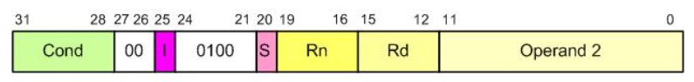
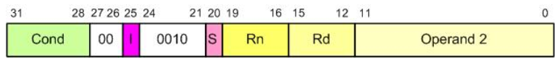
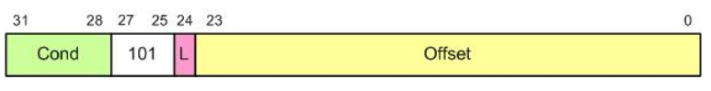
Instruction Formation
ADD instruction format
SUB instruction format
Branch (B) instruction format
Microprocessors and Assembly Language, Spring 2020, AUT, Tehran, Iran

Slide 6
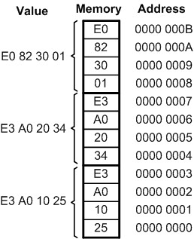
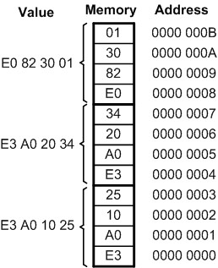
Little Endian vs. Big Endian War
Little endian
Low byte goes to the low memory location
High byte goes to the high memory address
All Intel processors
Big endian
Low byte goes to the high memory location
High byte goes to the low memory address
Freescale (formerly Motorola and now NXP)
ARM allows the software designer to choose!
A hardware switch that is controlled by software
Microprocessors and Assembly Language, Spring 2020, AUT, Tehran, Iran

Slide 7
Some ARM Addressing Modes
Microprocessors and Assembly Language, Spring 2020, AUT, Tehran, Iran

Slide 8
Addressing Modes
Addressing Mode
The various ways operands are specified in the instruction
Is the way CPU generates address from instruction to read/write the operands
Three basic modes
Register
Immediate
Register indirect (indexed addressing mode)
Microprocessors and Assembly Language, Spring 2020, AUT, Tehran, Iran

Slide 9
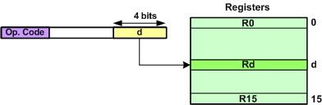
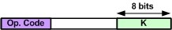
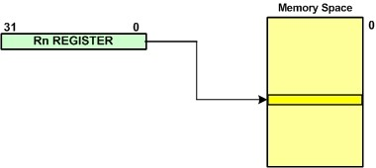

Addressing Modes
Register Addressing Mode
Immediate addressing mode
Register Indirect addressing mode (Indexed)
Microprocessors and Assembly Language, Spring 2020, AUT, Tehran, Iran

Slide 10
Addressing Modes
Register Indirect addressing mode (Indexed)
Can be used for pointer implementation
char *ourPointer; ourPointer = (char*) 0x12456; //Point to location 12456 *ourPointer = 25; //store 25 in location 0x12456 ourPointer ++; //point to next location
LDR R2, =0x12456 ; point to location 0x12456 MOV R0, #25 ; R0 = 25 STRB R0, [R2] ; store R0 in location 0x12456 ADD R2, R2, #1 ; increment R2 to point to next location
Microprocessors and Assembly Language, Spring 2020, AUT, Tehran, Iran

Slide 11
End of Chapter 2!
Microprocessors and Assembly Language, Spring 2020, AUT, Tehran, Iran

